Slide 1
Good luck and have a great break. If you’re graduating, good luck with your future. Do nice things.
Grades will be posted no later than tomorrow.

Slide 2
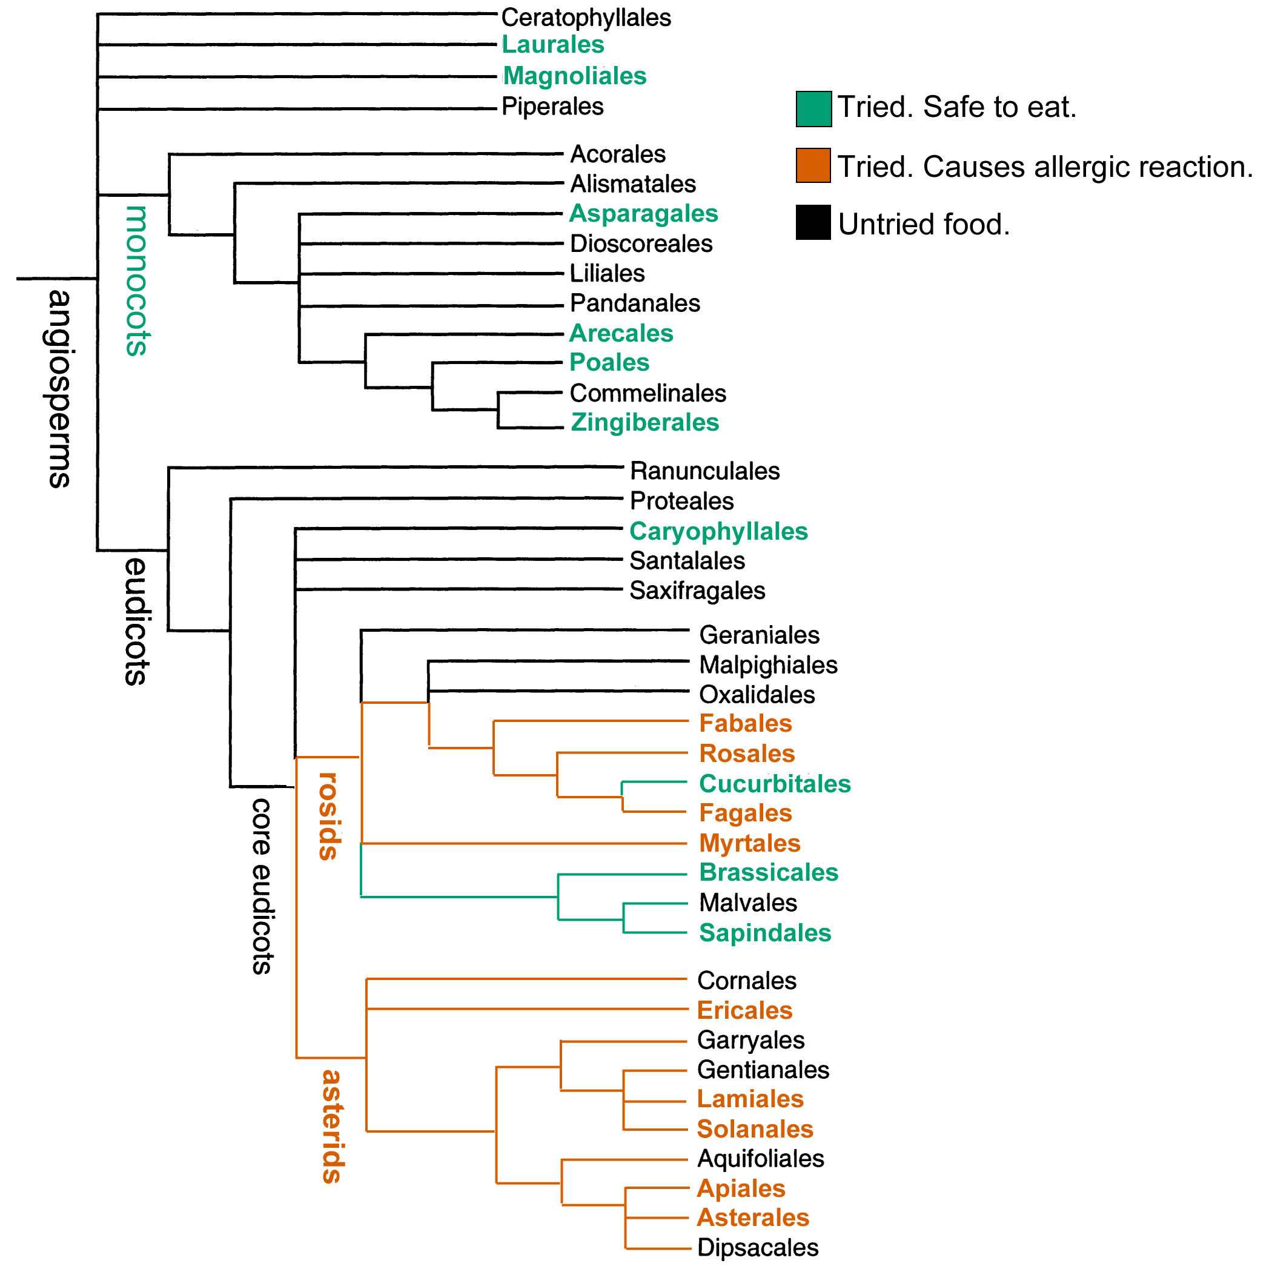
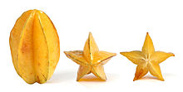
Question about
Christina’s
food allergies.
Oxidales
starfruit

Slide 3
Question about
Christina’s
food allergies.
Malvales

